Slide 1

The Machine Learning Journey
By: Daniel Immediato
Date: 5/03/24
Notes:
The third project was designated based on Kaggle’s Competition on the Ames, Iowa dataset focusing on predictive insights and machine learning.

Slide 2
Preliminary: What is the Ames Dataset?
Ames, Iowa is a college town of Iowa State University. The Ames dataset consists of the housing sale records between 2006-2010, including features like their area, number of rooms, and other attributes. The goal of this project was to create the most “accurate machine learning model with the best score”.
A machine learning model finds patterns from data. In our case, the data has 81 columns and 2580 rows. It would usually, then, make a prediction from said given data set.
A model’s “score” is a model evaluation, such as accuracy or R-squared, that explains the strength of the model.
This can be achieved by:
Reshaping the data into a workable state
Picking and then creating the best models that work for you
Tuning said models
Notes:
Basically, to begin this “journey”, we need a complete understanding of the data we are working with. It must be transformed into a state that can be used efficiently throughout each pipeline, without room for so-called data leakage. The ultimate goal is to create machine learning algorithms based on the transformed data, tune the algorithms as needed, and then provide an analysis of the results.

Slide 3
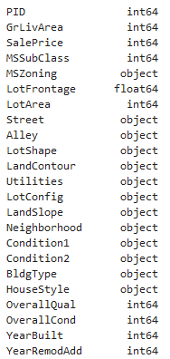
Preprocessing: Data Types
Before beginning any sort of analysis, one must examine whether or not the data “can” be anyalyzed properly to begin with. The typical dataset is split between numeric, categorical, and ordinal values. When coding, one has to ensure values are consistently classified throughout.
As a few examples, ‘MSSubClass’ is actually a category, not an integer, and dates, like ‘YearBuilt’ and ‘YearRemodAdd’, are also categories. PID is ultimately pointless as a feature when it comes to what we initially want to look at.
It is necessary to convert these to their proper data types, otherwise errors may occur or results may appear different than expected.
Variables like ‘OverallQual’ and ‘OverallCond’ must be manually encoded to a ‘least-to-greatest’ directory.
Notes:
The Ames dataset has multiple data types, with the majority being divided between categorical (string and object) and numeric (integer and float). When dealing with so many variables, it’s advised to properly assign the data types, otherwise preforming an analysis might not even work to begin with. As an example here, we know MSSubClass is a category, not an integer. This is important for OneHotEncoding, which is when one attempts to convert categorical data into a numerical format that machine learning programs can work with.

Slide 4
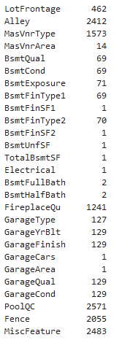
Preprocessing: Nulls and NA
An NA value is likely to cause the most issues when dealing with data. When running functions, depending on the program, many can’t process them and may produce an error or show results incorrectly. To deal with them you have several options, such as:
Assume what the value was going to be based on related values.
Replace values as a “0” or “none” if the value is legitimately lacking, or if there is no value.
Replace values with most common value or median.
Shown is an untransformed version of the “count” of all missing values in the dataset.
Notes:
Another preliminary to take into note is the amount of NA and Null values in your data. These can also lead to errors if they remain. One can drop the rows containing them, replace them with “none” or “0”, or replace them with the mean, median, or most likely value.

Slide 5
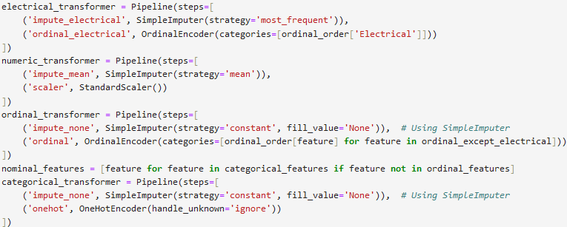
Preprocessing: The Pipeline
The problem with preprocessing independently of each other is that it can lead not only to data leakage, but as the code becomes increasingly complex, so does the requirement for automation. Pipelines can be used to condense “heavier” data processing into more easily digestible, and, more importantly, recallable steps.
For our purposes, the basic pipeline consisted of: separating the data types (and classifying them appropriately), deal with the “NA” values using a SimpleImputer, scaling the numeric values, and then encoding the categorical and ordinal values. These can then be combined into a preprocessor using ColumnTransformer.
Notes:
When first initiating the project, we originally did the preprocessing separate and individually. This is a problem with large data set, as not only is it hard to keep everything together (originally it was organized through .pkl files because of so many transformations), but transformations are done separately. This is different in a pipeline, where everything is applied to all transformers in a series. This simplifies the coding, avoids errors, and, most importantly, allows for recalling. Observed are the transformations done against each type of variable in one of the models, such as, for numeric, the mean was inputted for all null values, and the values were all scaled based on a StandardScaler.

Slide 6
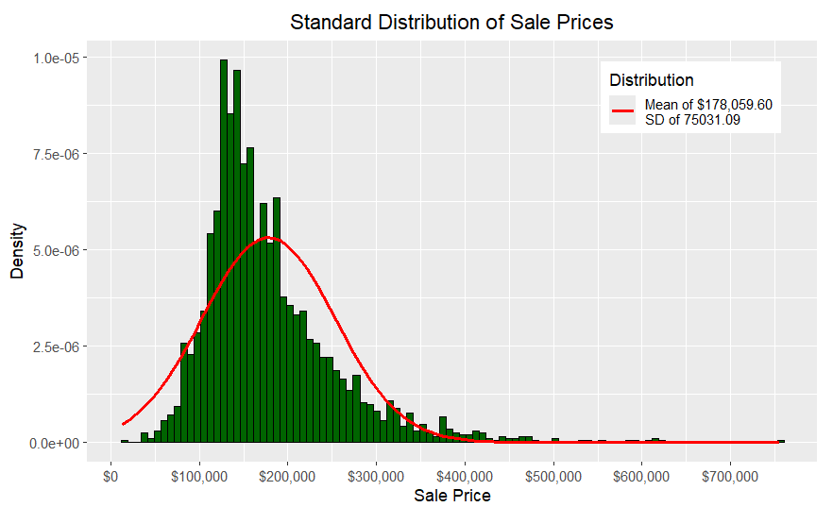
Overview: The Target
Our target, the ‘Y’ value, is Sale Price. This is the value we are measuring, and eventually predicting. Using a standard distribution histogram, we can see that most houses have been sold at around $180,000. This is fairly typical, as most people cannot afford more expensive houses.
However, it should also be kept in mind that there are numerous outliers in the data because of this. In fact, one can even be seen here, with a house being sold at over $700,000.
Notes:
The target itself is Sale Price, which will be used as the dependent variable for the models. When it comes to a standard distribution, we can see that most houses were sold at around $180,000. This makes sense since most people can’t afford expensive houses. We do notice outliers though. These outliers mean outliers for numerous other variables, like anything related to area and square footage, which can distort the data.

Slide 7
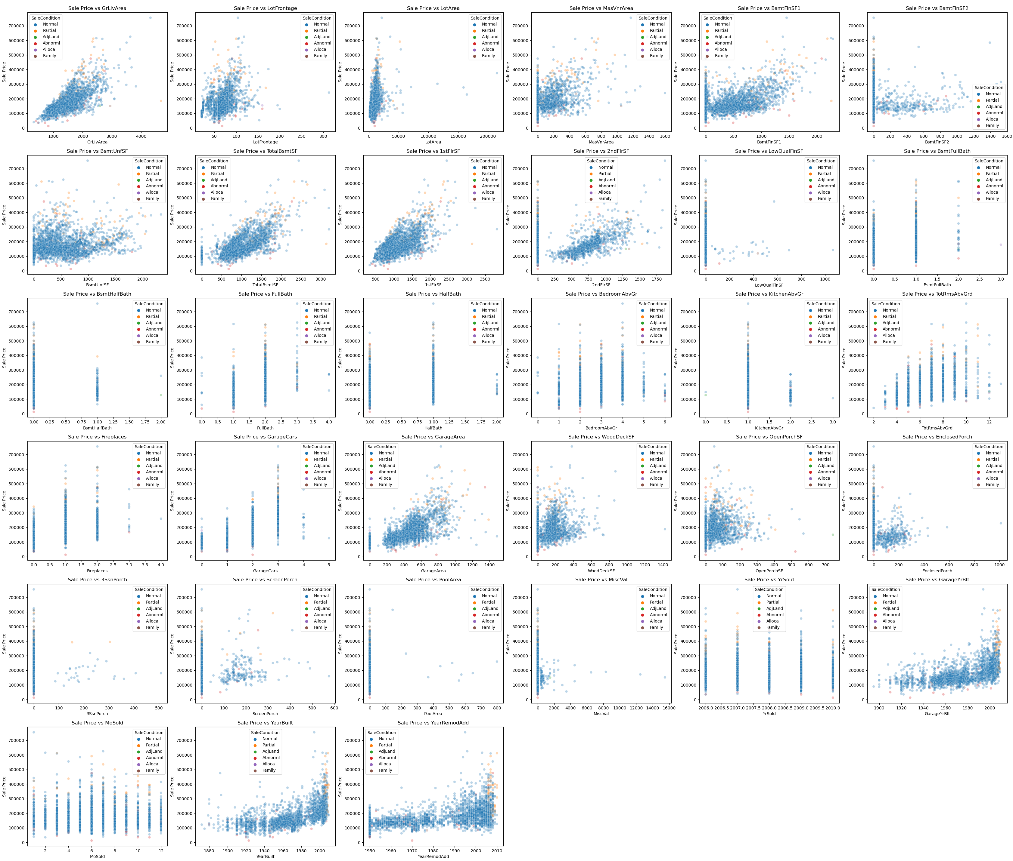
Overview: Numeric
Here is every numeric variable tested against the target, which is SalePrice. We can see many of the variables have some sort of correlation just from eyeing them, and we can also tell which might satisfy the features of linear regression.
We can also see which variables are ordinal judging by the spacing of the plot points.
Correlations can be extracted from this.
Notes:
Here we see a summary of the numeric features plotted against the target. As an overview, many of them seem to have a basic positive trend (just for example: the first one top left, above ground living area, appears to coincide with linearity). Noticeable are also the variables that are ordinal, where several still maintain that positive trend, such as size of garage in car capacity (2nd column, 4th row).

Slide 8
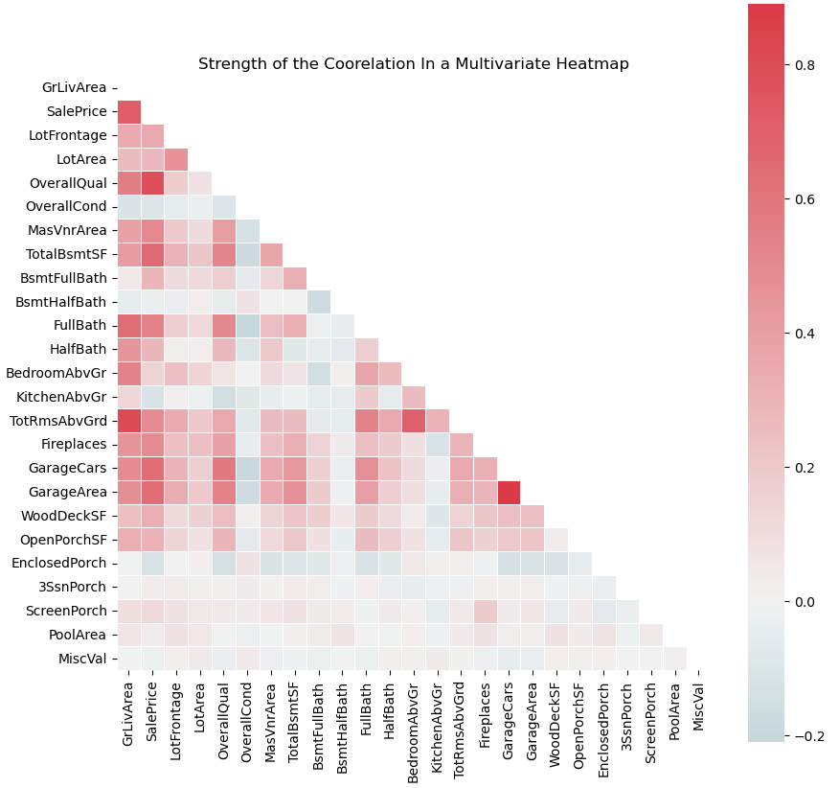
Overview: Summarizing Coorelations
To the left, we see the numeric and ordinal values (assuming it is ranked).
We can see that overall quality, ground living area, garage area, and others have higher correlation, while values like pool area and the “MiscVal” feature are of weaker strength.
This can be used to compare feature importance, as well as collinearity for a multiple linear regression model.
Notes:
Here shows the correlations of the numeric values. However, just because something is highly correlated, doesn’t mean that it is statistically significant. All this is telling us are that the correlations are highly affected by multicollinearity, which is what machine learning models are supposed to deal with.

Slide 9
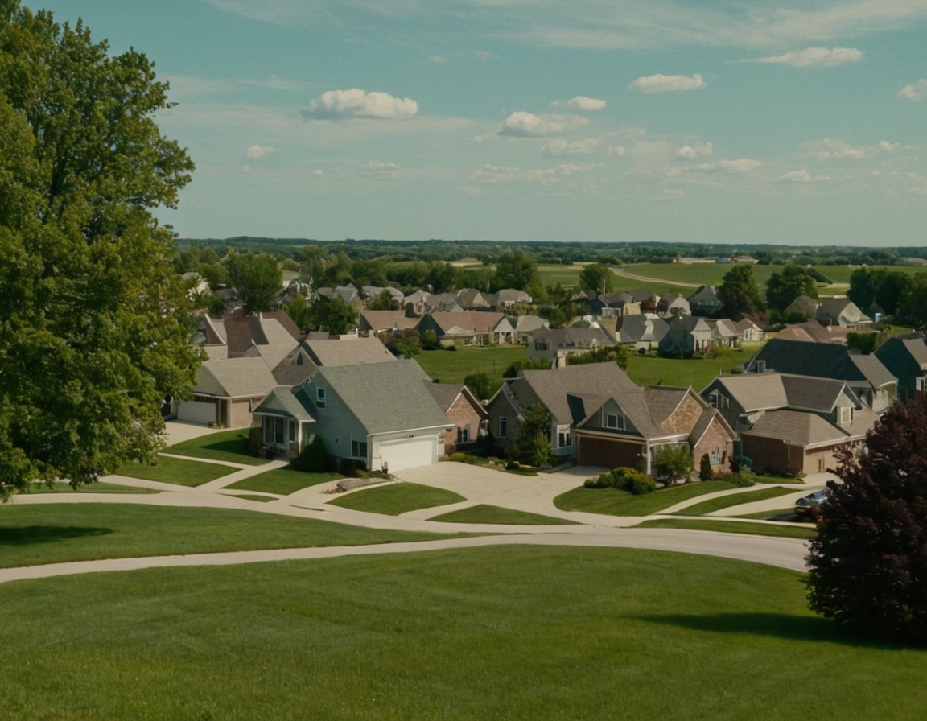
Multiple Linear Regression: As a Model
A MLR is used to determine the strength of relationships, as well as statistical significance. When used in machine learning, it is using the more than one x value (independent variable) to predict the y value (dependent variable)
This allows for the inclusion of several predictors, which an OLS (Ordinary Least Squares) model cannot do. This would, therefore, determine the significance of each predictor as well.
One must ensure features are linear to the target, there is constant variance, normality of errors, there is independence of errors, and that there is as little multi-collinearity as possible.
(Image Created Via Stable Diffusion)
Notes:
The previous graphs showed what a stats model could analyze. As a model, regressions determine the strength of relationships between variables, as well as the statistical significance. A MLR model is unique in that it deals with multiple predictors and can be subject to multi-collinearity, where the more and more features that are added, the increasing likelihood that said features are going to influence each other and the outcome.

Slide 10
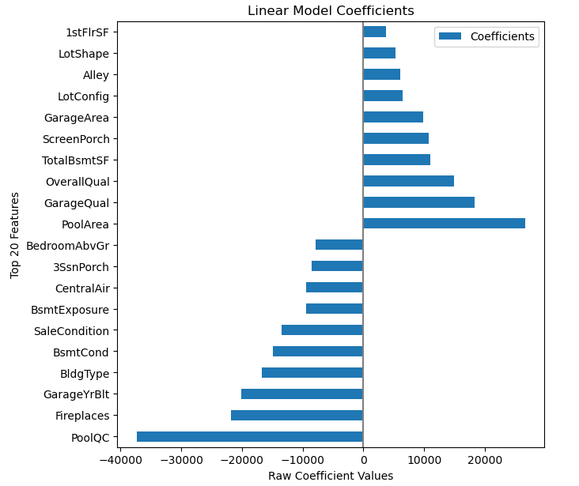
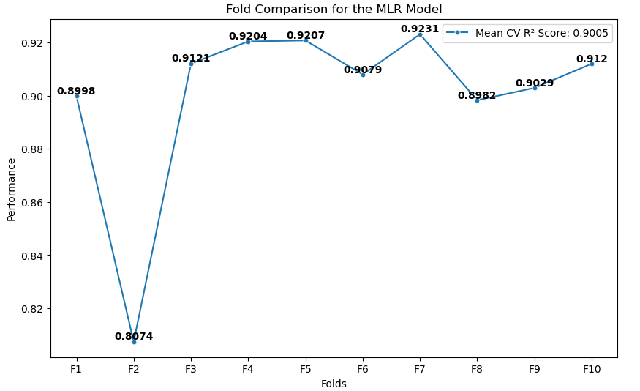
MLR: The Transition From a Stats Model
An OLS model would typically give coefficients, standard error, and a P-value. The MLR mainly provides the intercepts and the coefficients, but is able to provide predictions at the cost of standard error.
Cross-validation score is the performance of the model on unseen data. The data is split into groups, called folds, of hopefully equal size so that different models are being trained in order to improve accuracy and performance.
Notes:
The MLR tells us the relationship of the multiple features and their relationship with the target value. Here, the initial fold is the validation set, and the model uses that method on the rest of the folds. This explains why there is such a sharp difference between the first and second fold. The model had nothing else to go on. It then starts to relatively level out over a steady mean of .90. While maybe not optimal, the model isn’t experiencing much performance degradation with further inputs, until reaching fold 7, where there is a drop. This was also tested with five folds, which had a lower mean of .89.
We can also get the coefficients from the pipeline. Here, it tells us that features like Pool Area and Garage Quality will cause sale price to increase by a larger amount with each increase in unit of relative value (note that the values were encoded). Although not shown, the MLR model also told us that the feature with the highest predictability was ground living area.

Slide 11
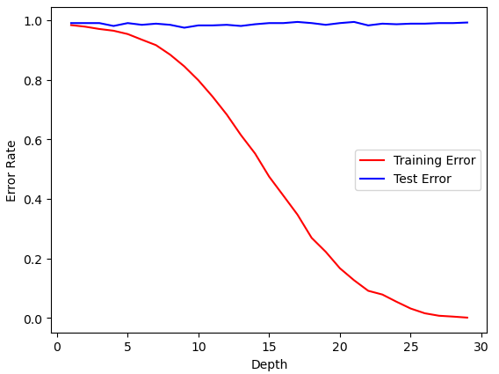
Regression Models: Lasso, Ridge, and Elastic Net
Multiple-regression models are used as regularization techniques to deal with the problem of "overfitting", which occurs when the model is too closely adapted to the training data.
The Lasso regression selects only the most relevant features, while the Ridge model reduces sensitivity to change by penalizing the "largest coefficients". Elastic Net is a hybrid of both.
All have the goal of reducing model complexity, handling multicollinearity, and making predictions more explainable.
Example of overfitting in a decision tree: High test error, but low training error. We want to prevent this.
Notes:
We used three different regression models for the project, each having their own positives and negatives, and each having different model scores. The ultimate goal was to find which regression model had the highest score across all folds when compared against each other. Regression models are also useful for feature selection.

Slide 12
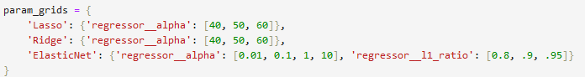
Regressions: “Default” and “Tuned” Models
The default model is the version of the model that has not been affected by parameter tuning, or anything related to it. It is the most basic cross-validation score one can get. In an ideal scenario, the default model is kept if it is superior in score to a tuned model.
The tuned model is subject to parameter tuning, done through a grid search to find the best combination of "hyper-parameters" to find the highest accuracy. This is done manually with “ranges” of parameters, although for the regressors only the alphas were used.
Below is an example of parameter tuning. Note the difference for elastic net, which corresponds directly to the lasso at 1, but then shrinks to the ridge as it approaches 0. Python will find the “best parameters” that lead to the “best score” out of these. In our case, it was 40 (and nothing below that), .1, and .9, respectively.
Notes:
The regression models begin as the defaults, which are the basic cross-validation scores. These are unaffected by any sort of parameter tuning. Hyper-parameter tuning is an attempt to control the values of the model’s parameters in the learning process, in order to achieve better results. It is a progressive process, where one would input ranges of parameters, adjust the ends of the ranges once the “best parameters” are found, and finally end on the parameter when the ends no longer change.

Slide 13
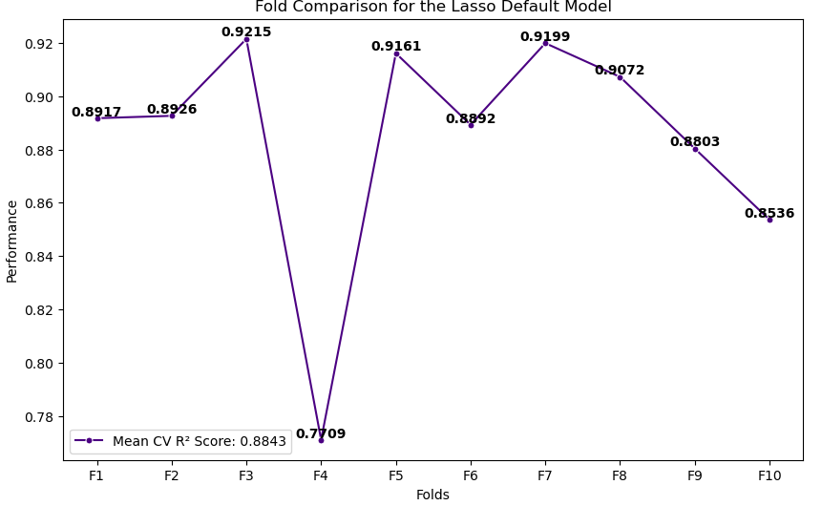
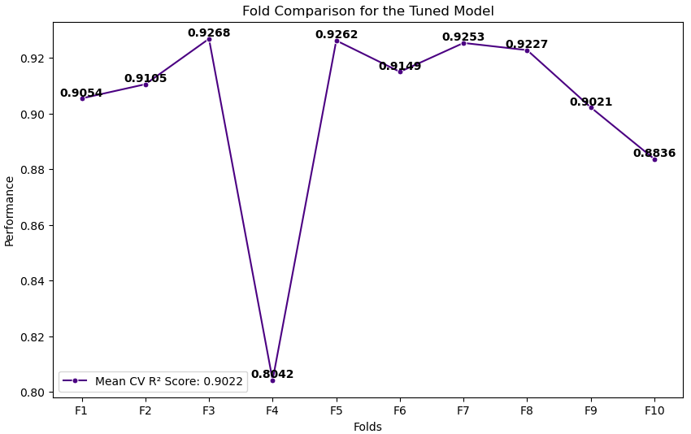
Regressions: The Lasso
The Lasso regression selects only the important features in a data set, while also reducing complexity. It is one of the fastest models out of the three, if not the fastest, and can handle larger number of features.
The problem with the Lasso regression is that it is attempting to shrink the coefficient estimates to zero. This means that, because it will only retain one variable, a highly correlated model will end up having lower accuracy and a loss of information.
Notes:
The lasso selects important features and can reduce overfitting in the process. However, it has a problem when encountering data sets that are highly correlated, and can tend to be biased. We see in the default version that the folds have degradation, with a sharp drop at fold four. The variation is seen more widely with a five-fold model, and is actually steadier here, but this shows the instability of the lasso, and how it arbitrarily selects one variable over time.
The tuned model is visually similar to the default model, with the caveat that all values at all folds are superior to the default model. Plus the tuned model as a higher mean as a result. Regardless, we can still see the degradation trend typical of the lasso.

Slide 14
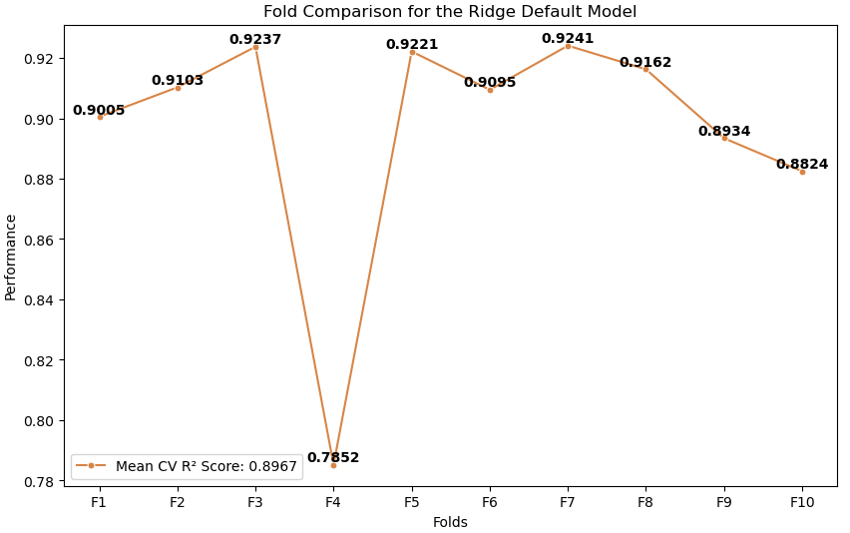
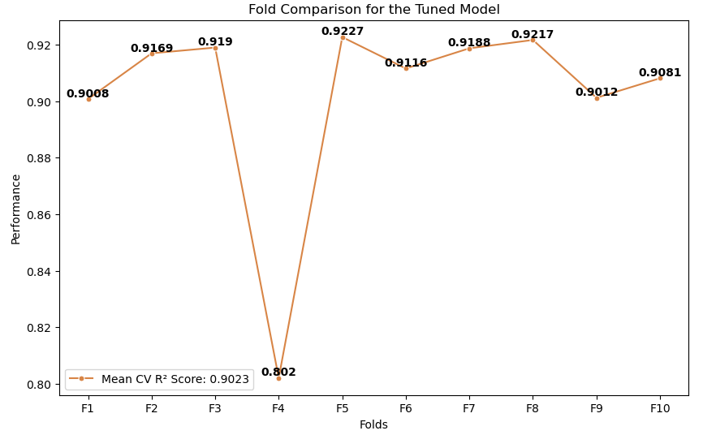
Regressions: The Ridge
Ridge regressions retain all the features in the model by only shrinking the coefficients, instead of setting them to zero like in the Lasso. This means there is no feature selection and less bias than the Lasso regression, at the cost of making the model more complex.
Notes:
The ridge model is similar to the lasso model, except it has no feature selection and trades variance for bias. In fact, its fold comparison is visually similar to the model, having a mean slightly higher. Most notable, the Ridge model has degradation in the default variant, but does not have the steady degradation like the lasso did as the folds increased past fold 7. This already shows the greater stability of the model.

Slide 15
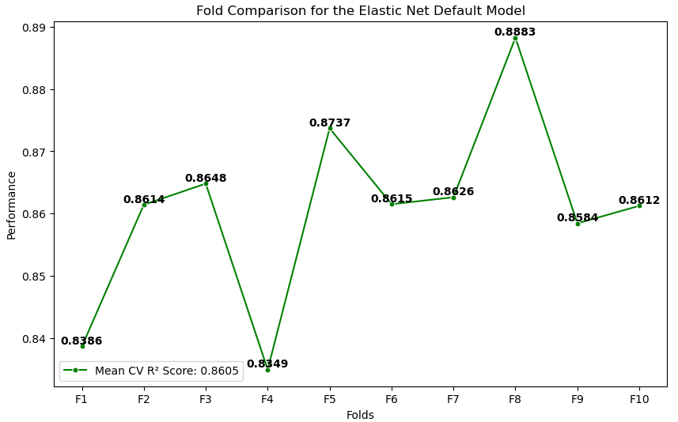
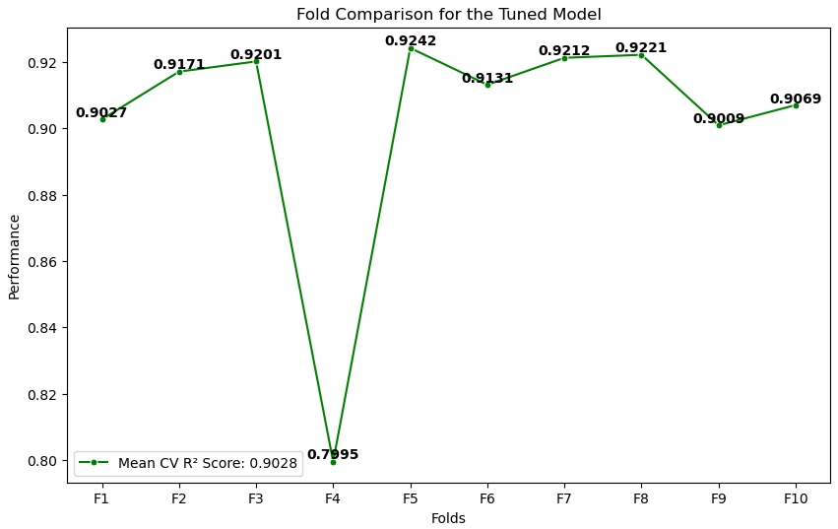
Regressions: Elastic Net
Elastic Net is a hybrid model, adding a penalty equivalent to the sum of the absolute values (L1-norm) of the coefficients and the squares (L2-norm) of the coefficients. It is used when the Lasso becomes too dependent on a particular variable.
The problem, being that it is a hybrid, is that the Elastic Net is extremely computationally intensive.
Notes:
The elastic net delivers the most varied results when it comes to the default model. *I do not know why it looks like this and will ask Vinod*. The tuned model, on the other hand, visually resembles the Ridge model the most . In fact, the elastic net, when tuned, has the greatest Mean CV R2 of all the regression models.

Slide 16
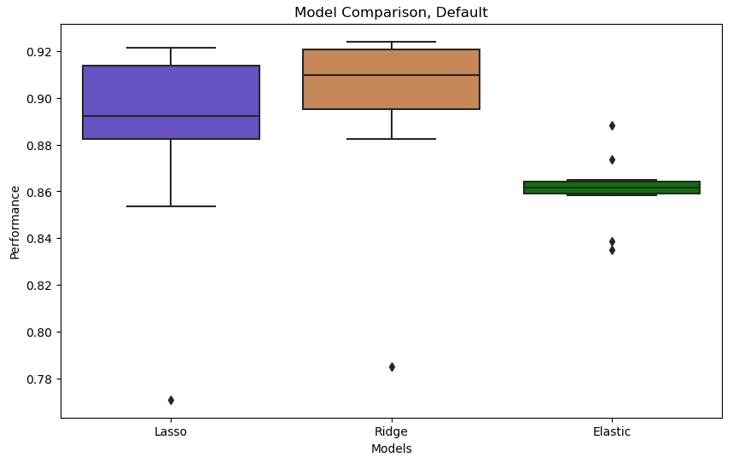
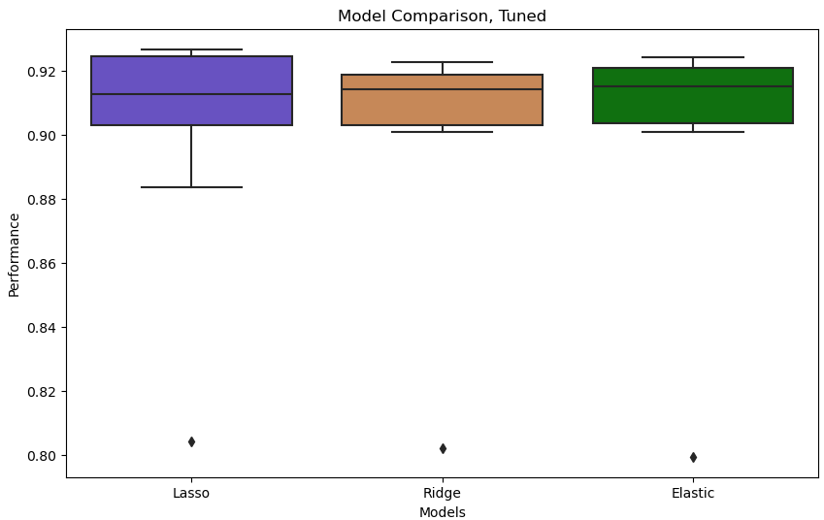
Regressions: Model Summary
When it comes to the default, the Elastic model had the lowest mean CV score, while the regression model had the highest. The tuned model, on the other hand, has the elastic having the highest mean CV score, but the lasso, overall, has some of the highest fold scores out of the three.
It should also be noted that the tuned Elastic model has one of the lowest fold score of the three, while the Lasso seems to have the greatest variation.
Notes:
The model comparison shows the superiority of the tuned models. Not only are the models more compact, but they all have higher mean scores and it becomes easier to choosing a model. Overall, it’s a tossup between the elastic net, which has the highest mean score but one of the lowest fold scores, and the ridge model, the most compact model and originally having the highest score in the default. However, for simplicity’s sake, one would probably choose the Elastic over the Ridge in this scenario, despite the Elastic being so computationally intensive (*check with Vinod*), especially considering the difference in score is .0005 points.

Slide 17

Random Forest: As a Model
A Random Forest model combines multiple decision trees into a single model. In this case, it would determine feature importance rather than, for example, a MLR's correlations. Feature importance is a degree of dependency on the variables being compared. The higher feature importance, the larger the effect it has on the model.
A Decision Tree is a hierarchical structure where each "node" represents branches based on different conditions being satisfied. As seen before, decision trees are subject to "overfitting", which can lead to "poor predictive performance".
(Image Created Via Stable Diffusion)
Notes:
A random forest model is used to find feature importance, or the degree of dependency of variables. It is the combination of multiple decision trees, the hierarchical structures that use nodes to test attributes. Overfitting is when the test error no longer nears the training error as the model complexity increases.

Slide 18
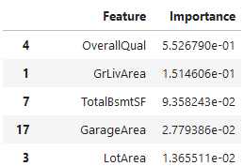
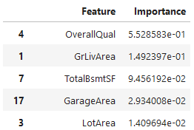
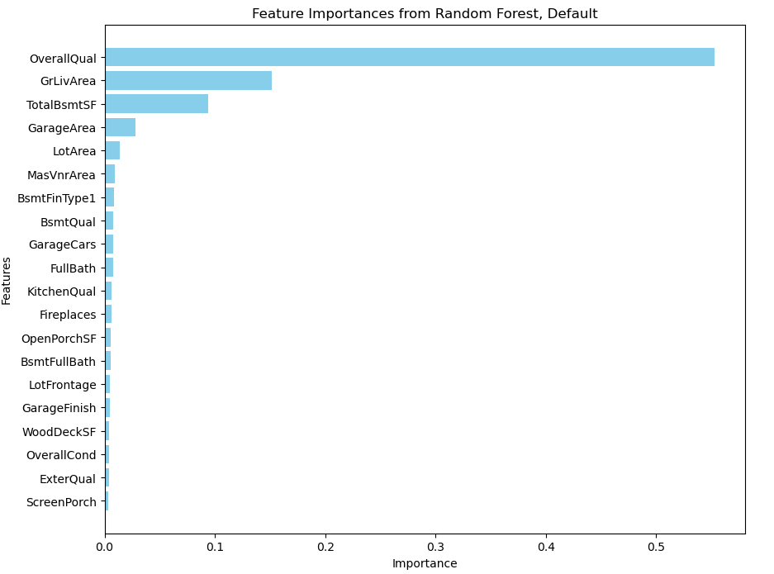
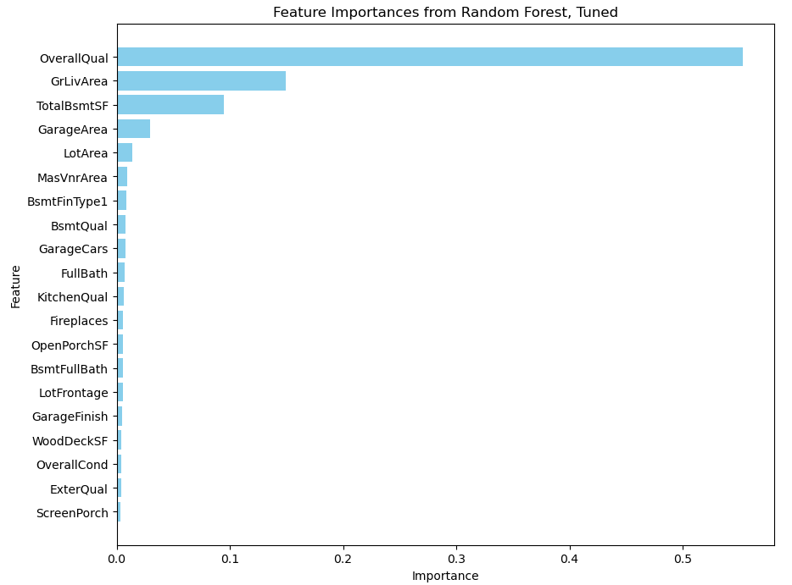
RF: The Feature Importance
With visually indistinct feature importances, the random forest models tell us not only a ranking of the features, but a model score. However, the model score, which is .886, is so close between both models it is almost not worth adjusting the default parameters.
To the right, one can see just how close the importances are.
Notes:
The default model of the random forest has a CV score of 0.886257, while the tuned model has a CV score of 0.886412. This is extremely close, and shows that sometimes parameter tuning doesn’t change much. However, random forests are distinct in the extent of their tuning in that the parameters can be adjusted to such a degree that the results can vary widely, usually based on the amount of “splits”, “leafs”, and number of features. This can also compound the number of fits by a large amount. The top right lists show just how close the differences were, with the shown Tuned features having slightly higher importances except in regards to ground living area.

Slide 19

Gradient Boosting
Gradient boosting combines weaker models (usually decision trees), and adds said models sequentially, where each "addition" tries to make up for the errors made by the previous ones. The final prediction is an aggregate sum of the individual predictions.
Because of the sequencing, the gradient boosting model reduces bias with the addition of each additional leaner. This further allows for greater accuracy, especially on larger data sets.
(Image Created Via Stable Diffusion)
Notes:
Gradient boosting is an ensemble technique that takes multiple “weaker” models and combines them into a collectively more accurate model. The weaker models are added sequentially, where each addition fixes the errors made from the previous.

Slide 20
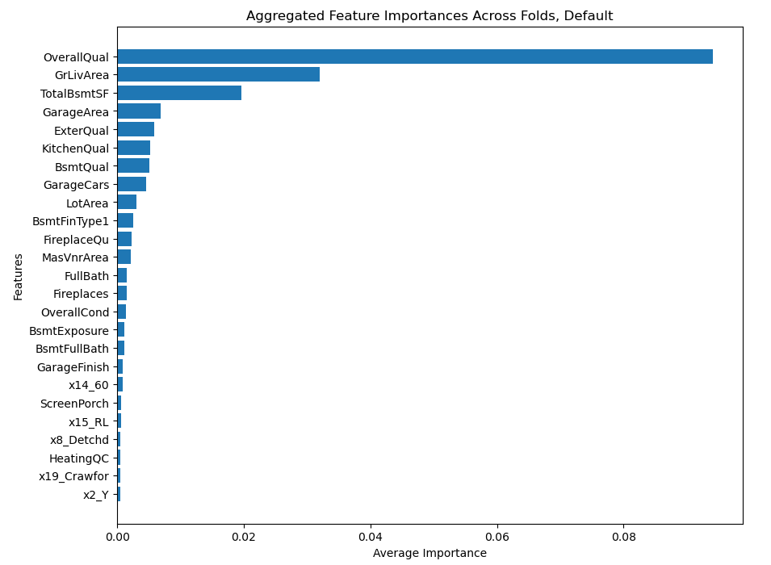
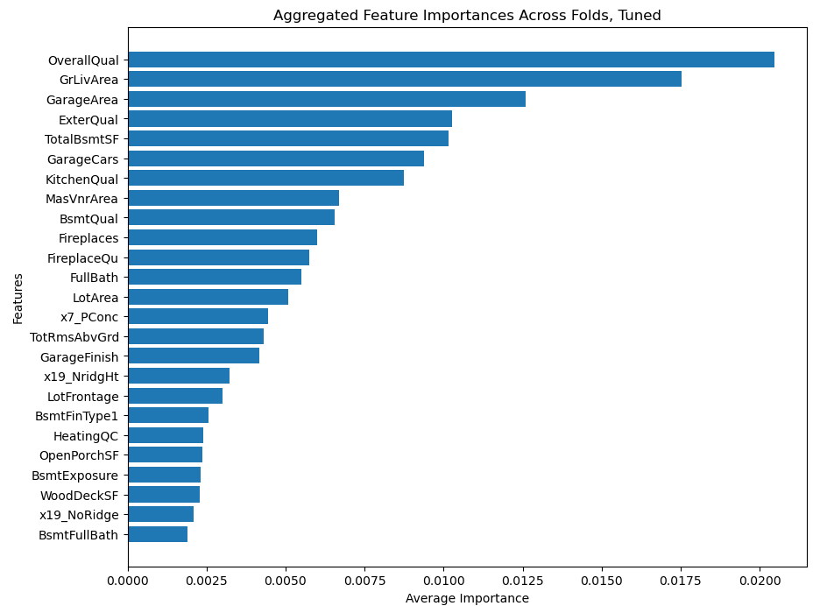
GB: The Booster
The Gradient Boosting model is an interest one as its tuned version is had the best model performance out of all models, but the feature importances had a stark contrasts to each other. “Rank” should be looked at instead of the “strength”, as the GB will start taking into account One Hot Encoded values, which were a part of those weaker models.
Notes:
The GB model has the highest tuned score of all models presented, with an average CV score of 0.9056. This beats out the elastic net by .003 points. However, it should be noted that its importances appear to be quite different. The overall average importance is lower in the tuned model, plus the ranking is different. Yet the default score was 0.8947, just a .1 point difference. This can be explained by its parameters, much like how the random forest was done. The gradient boosting has feature parameters, where this was subject to a square root instead of the random forest’s “none”, as well as specified depth.

Slide 21
Summary: Results
The models themselves all have their strengths and weaknesses, but the results bring out which models may be preferred over the other. Of the regression models, the Elastic Net has the highest average CV score, although not by much of a margin.
On the other hand, the Gradient Boosting model is the strongest model of the six, while the Random Forest model is the weakest. The MLR model was the only model that actually performed worse when subject to a tuning, so it was left untouched.
MLR Default Score | Lasso Default Score | Ridge Default Score | EN Default Score | RF Default Score | GB Default Score
0.9005 | 0.8844 | 0.8968 | 0.8605 | 0.8863 | 0.8947
MLR Tuned Score | Lasso Tuned Score | Ridge Tuned Score | EN Tuned Score | RF Tune Score | GB Tuned Score
N/A | 0.9022 | 0.9023 | 0.9028 | 0.8864 | 0.9056
Notes:
When compared side-by-side, the hypothetical “best” model to be used would be the gradient boosting model. However, all of these models would be situational based on what one is trying to find and what kind of data one is working with. For example, some models work better with multicollinearity than others, while other models deal with larger data sets than others. And just because you would choose one of those models, doesn’t necessarily mean that the model in itself is “inferior” because its score was lower, rather, much like parameter tuning, you’re supplementing the score pitfall with the model’s benefits.

Slide 22
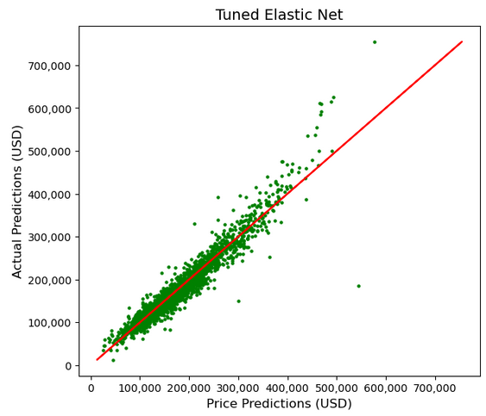
Final Thoughts: Linear Models
The regression models are an interesting case in that they all not only are varied, but all have their advantages and disadvantages. Some of them are specifically used in certain situations, but after using four of them, there’s no one that actually stands out well-above the rest.
Therefore, it ends up turning into a “pick-and-choose” situation, where one would select regression models that suites the situation to compare them alongside other regression models. This is fine because, in our experience, these models are: compact, easy to use, and similar enough to each other that they can be compared with ease.
Take this prediction for example from the Elastic Net. This is nearly identical visually across the regressions, so it’s pointless to show a different one.
Notes:
The regression models felt like the easiest to get acquainted to due to their ease of use. They have set advantages and disadvantages, plus they can be compared alongside each other when one wants to start expanding the model range. The problem, as seen in the project, is the lack of variety in the results. The regression models (excluding the elastic net) were strikingly similar to each other, even when run across ten folds, with nearly identical scores. While not necessarily a bad thing, it gives credence to the “pick the right model for the data”, in order to avoid making you feel like you wasted your time.

Slide 23
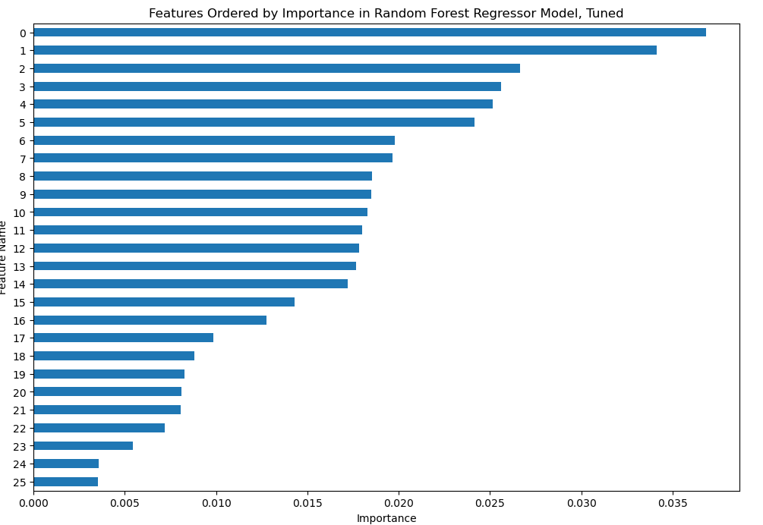
Final Thoughts: Random Forest
The Random Forest is an interesting case as we found it to be the most unique out of the models presented. Although not shown, its construction method is visually distinct and that allows for greater parameter tuning.
Yet even with that ability, it happened to be the weakest of all models. Worst of all, it was the most computationally expansive of all models. This is due to the parameter of “feature”, a parameter that has the chance to completely change the results. For example, to the right are the RF results if “feature” was square root instead of none. It would have a lower score, but everything would have higher importance. Note its similarity in appearance to the GB model.
Notes:
The Random Forest model is impressive in that it is a streamlined result of multiple decision trees. This makes it separate from the linear models in that ordinal encoding actually matters, but more importantly, a lot of information can be extracted from just the one model. However, its weakness is its complexity. So many leaves makes it a very large model, even worse than the elastic net, and, in our case, it thought all of the features was optimal to get the best score. The problem was that, even in that case, it still resulted in the worst model.

Slide 24
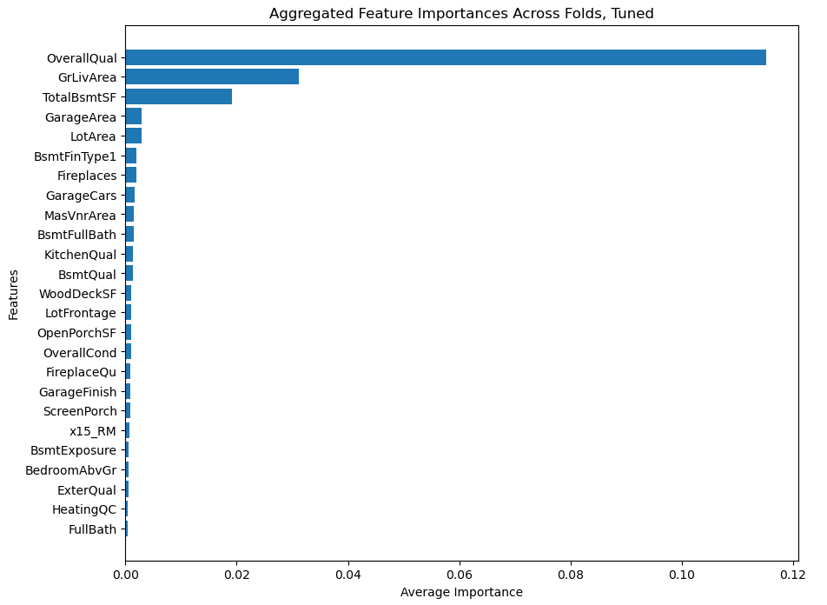
Final Thoughts: Gradient Boosting
A similar model to the Random Forest, the Gradient Boosting model was the best model in performance out of the six. It was computationally impressive (even with a “none” parameter, it was still faster than the RF), and allows one to extract similar results from a RF model.
Included to the right is if square root was not used for the feature parameter, which shows just how similar the importance would be to a RF model. Its average importance is still weaker, but the spread is almost identical. However, this version of the model had a much weaker score than the version that was chosen.
Notes:
Literally acting as a “booster” the GB model proved to be the best model of the six. Most notably, however, is its similarities to the RF model, the weakest model, even when you can extract similar information from the two. For example, when similar parameters are used (at the cost of the loss of score), the average importance looks almost visually identical to what the RF presented to us.

Slide 25
Areas For Improvement
Feature Selection: We never actually used the MLR model for feature selection, which can be used to further tune the model.
Beyond Score: The goal of the project was to find the model with the best score. While we did dabble in some other results, ideally one would use the models to truly find out the limits of what they’re capable of.
Pipeline Changes: The data was edited in pipelines, done in different ways throughout the models to match their specifications. Obviously, the feature engineering was not perfect and can be changed to better adapt to certain models. Just for an example, the mean was used to fill null values for the numeric features. Sometimes this isn’t ideal.
Other Models: Other models can be used to address various issues. This includes classification modeling (regressors were used), so-called XGboosting and AdaBoosting, and bootstrap aggregating. Additionally the parameters can be adjusted.
Modeling
Data
1
Predictive Reliability: The score for all models was lower than desired. Ideally, they should all be above .90.
1
2
2
3
3
Feature Engineering : Some features were changed to account for their uselessness in the grand scheme of the data. This can be done for other features, such as with total baths.
Notes:
There are many areas that can be improved. In regards to the models themselves, the predictive reliability was low. This can be increased using various methods related to other areas for improvement, such as a lasso regression for feature selection. Another problem frequently brought up is how the primary goal of the project was finding R2 score. While that’s how one would find the best model to work with, one would then have to use the ideal model to actually find results with it. Although mentioned and shown briefly, a comparison between results would have been beneficial. Additionally, as always, other models can be attempted to find either a better overall score, or a better model that suites our needs. We could always attempt to further adjust parameters as well.
In regards to the data, feature selection using the MLR model can be used to tune the model. In addition, we could select certain variables ourselves to test against, instead of using the entire data set. The pipelines can also always be edited, such as how they would handle missing values or even outliers, which were briefly mentioned. Certain features can also be combined, like making a total baths one, in order to reduce redundancy.

Slide 26
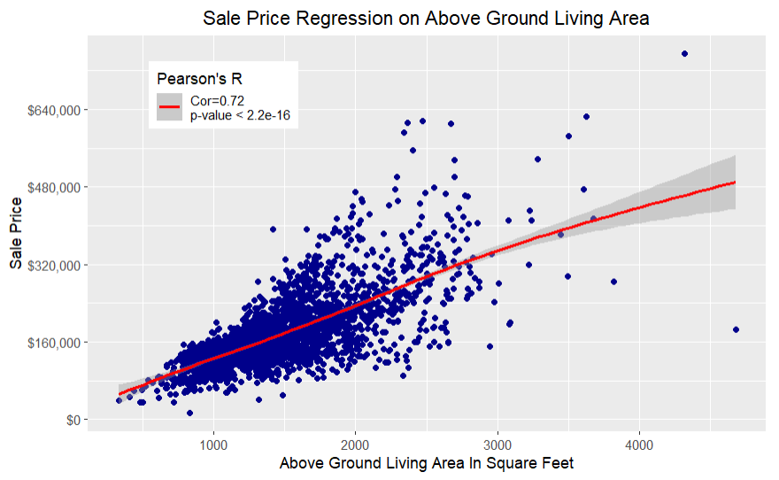
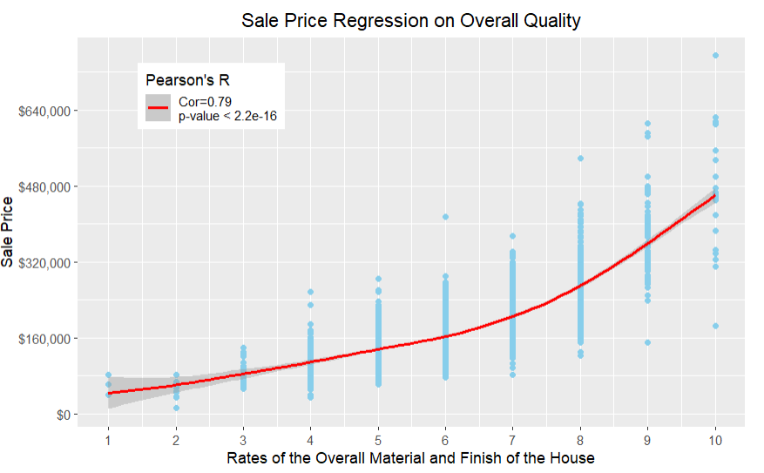
Questions? Comments? Suggestions?
Massive thank you to my mentor Vinod, who pushed me well beyond what I knew to complete this project.
Notes:
Massive thank you to my mentor, Vinod. If anyone is curious, here are also two independent regressions of the two features that had the highest importance in the GB models.

